Slide 1
Experiences while quarantining Casa San José
2020
Notes:
1

Slide 2
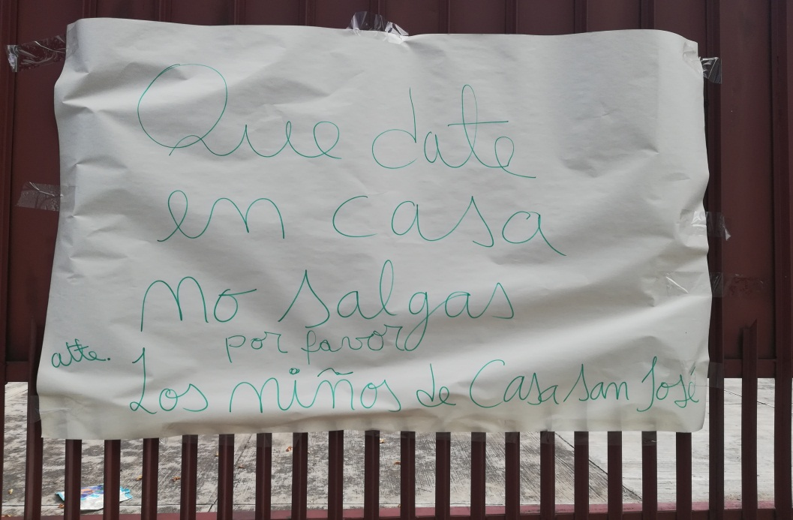
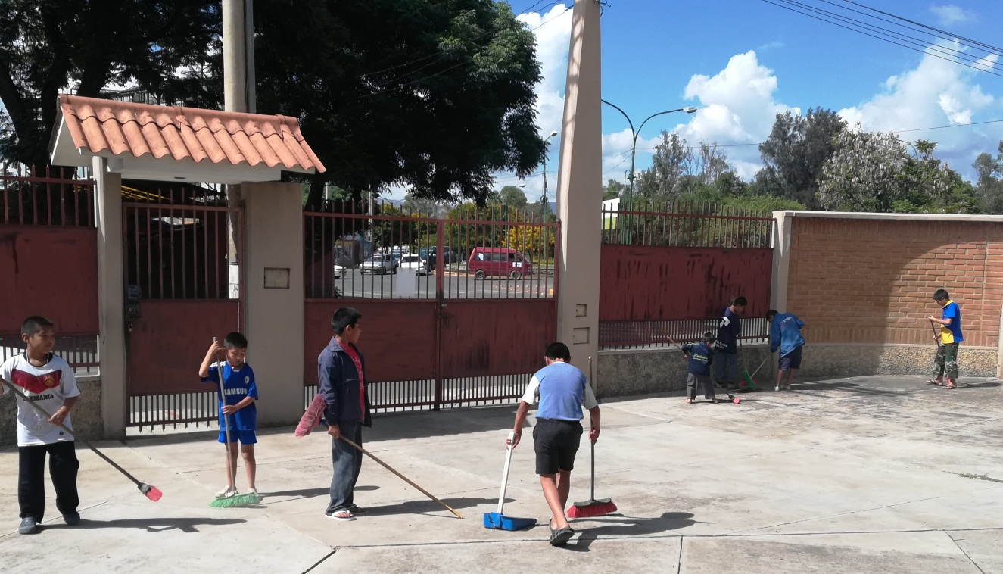
We start our Quarantine
He’s not
moving!
Hurry, Harry
…
Notes:
2

Slide 3
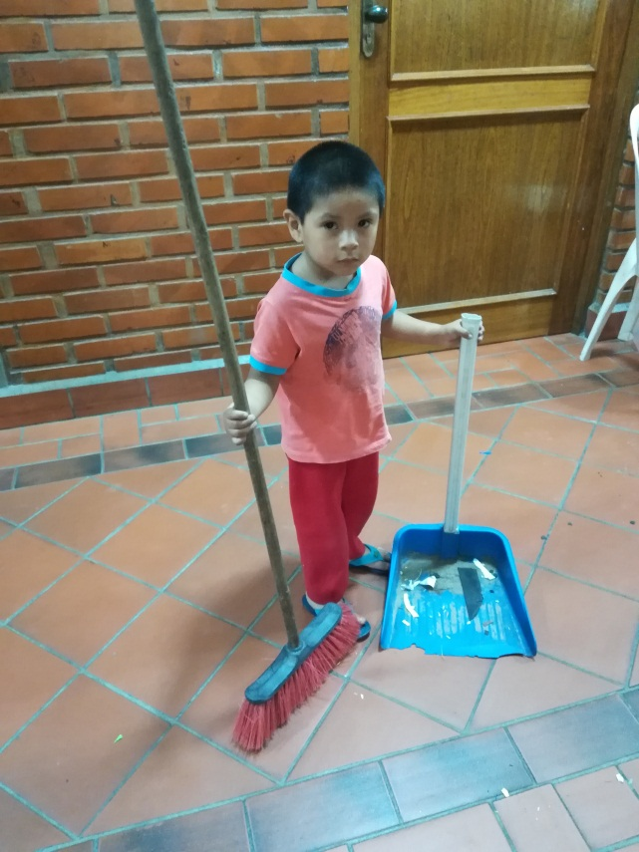
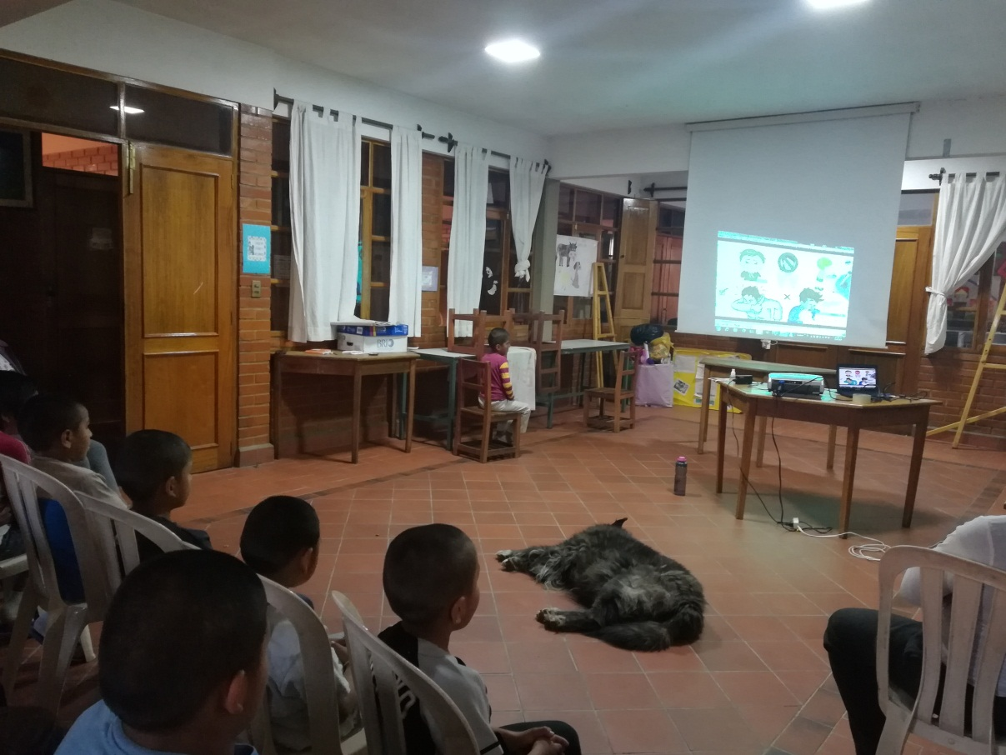
Ufff; I am finally done with my chore…….
In the Classroom
Bone
Notes:
3

Slide 4
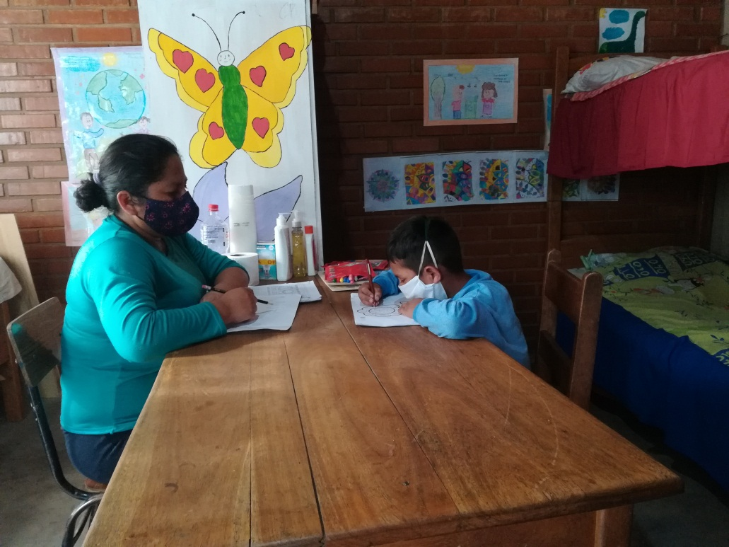
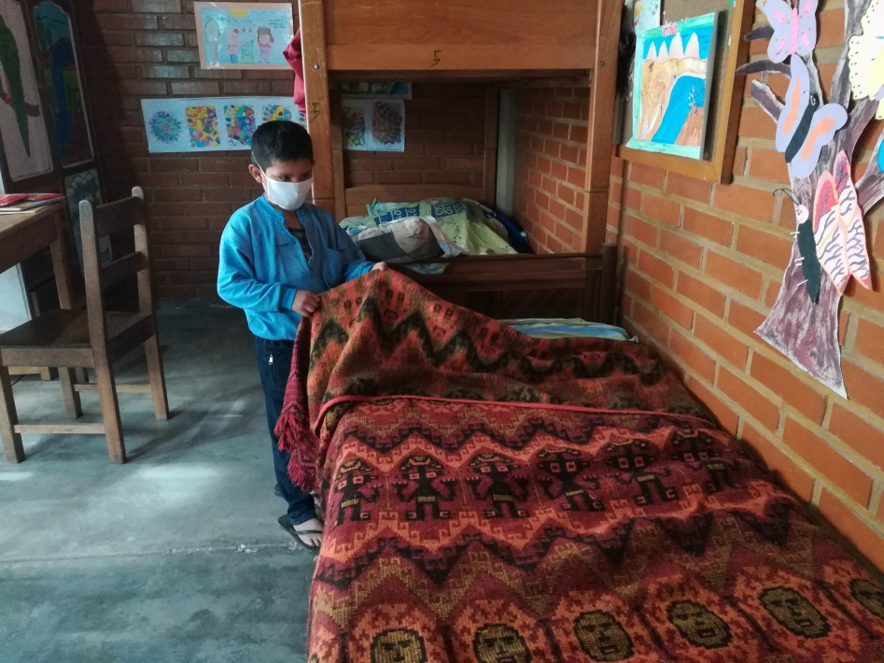
No-one is allowed to leave the house.
Isolation Room
So I just stay here?

Slide 5
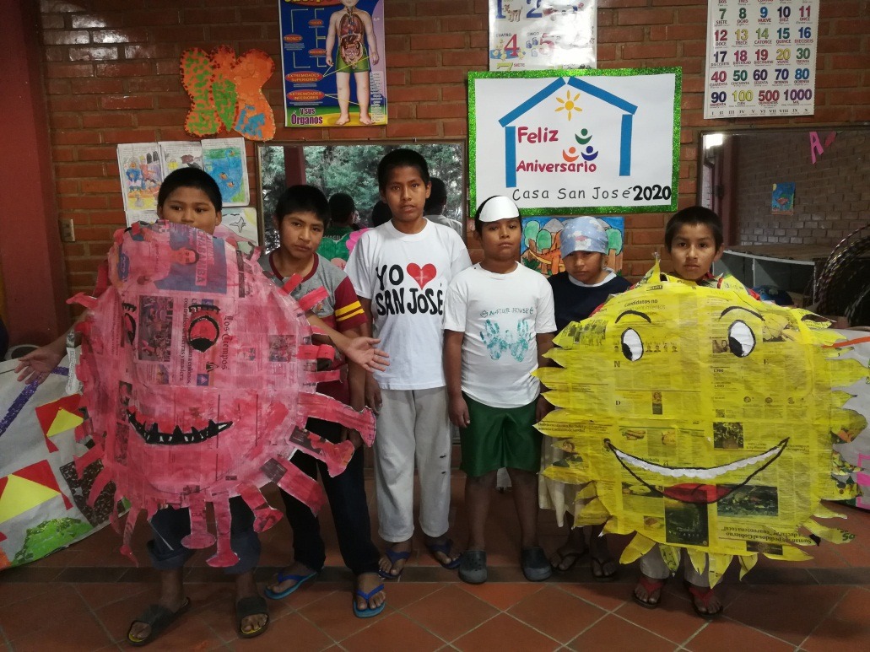
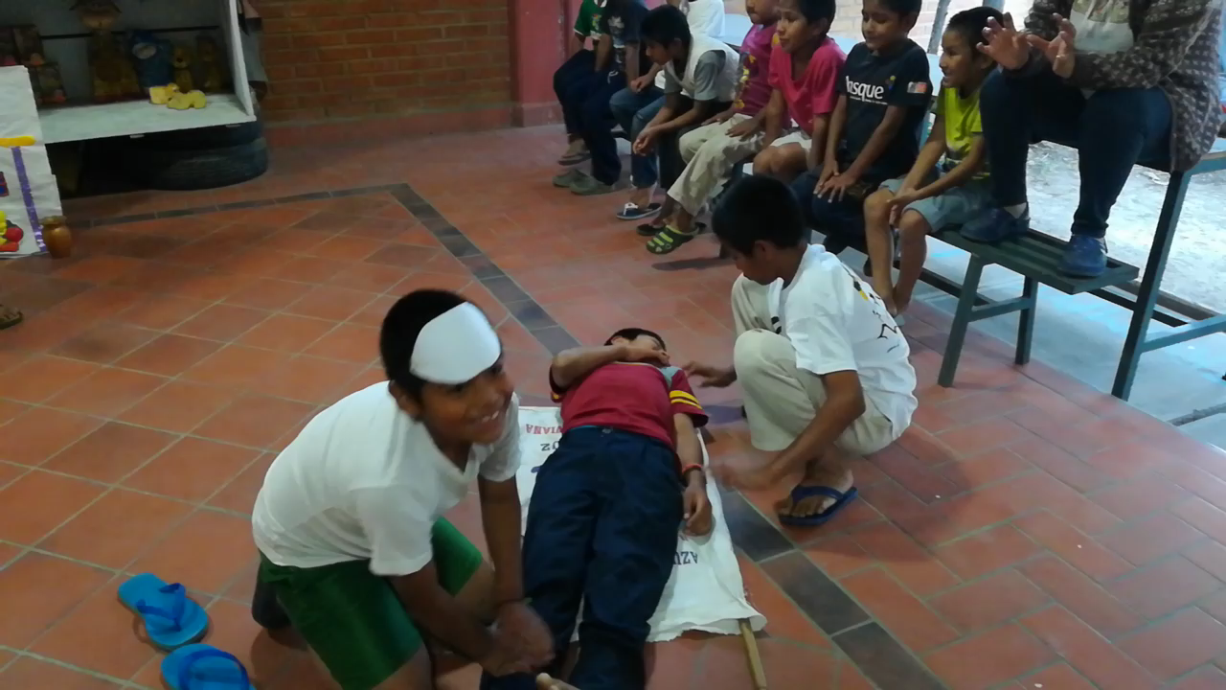
What we learned about the Virus.

Slide 6
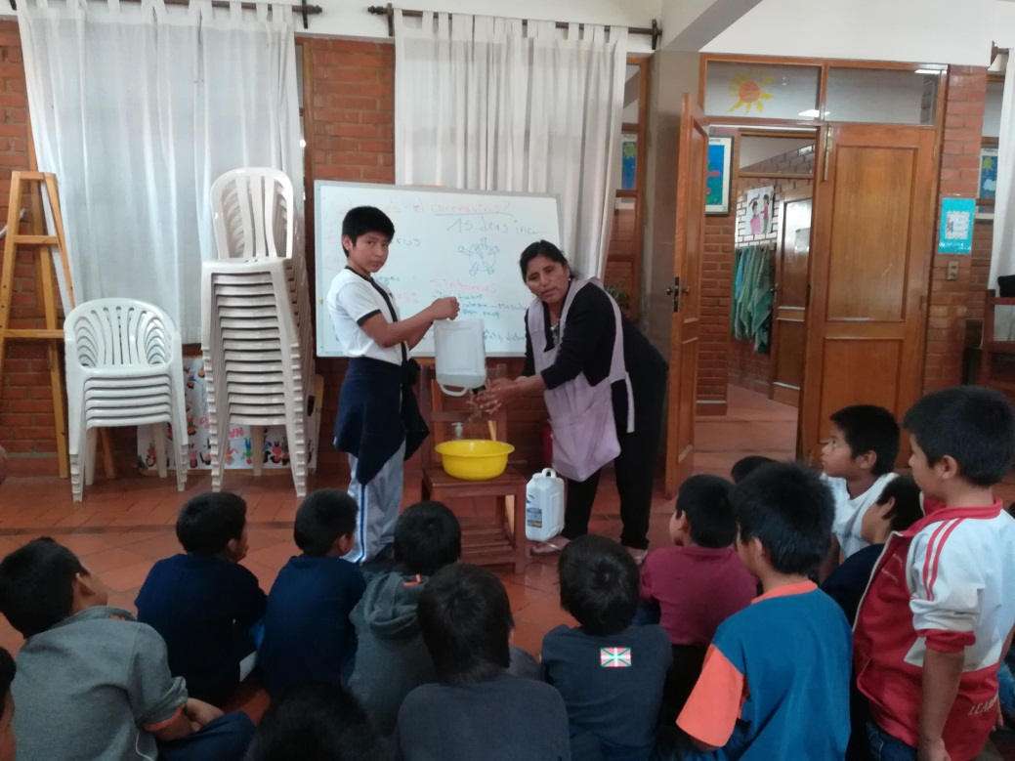
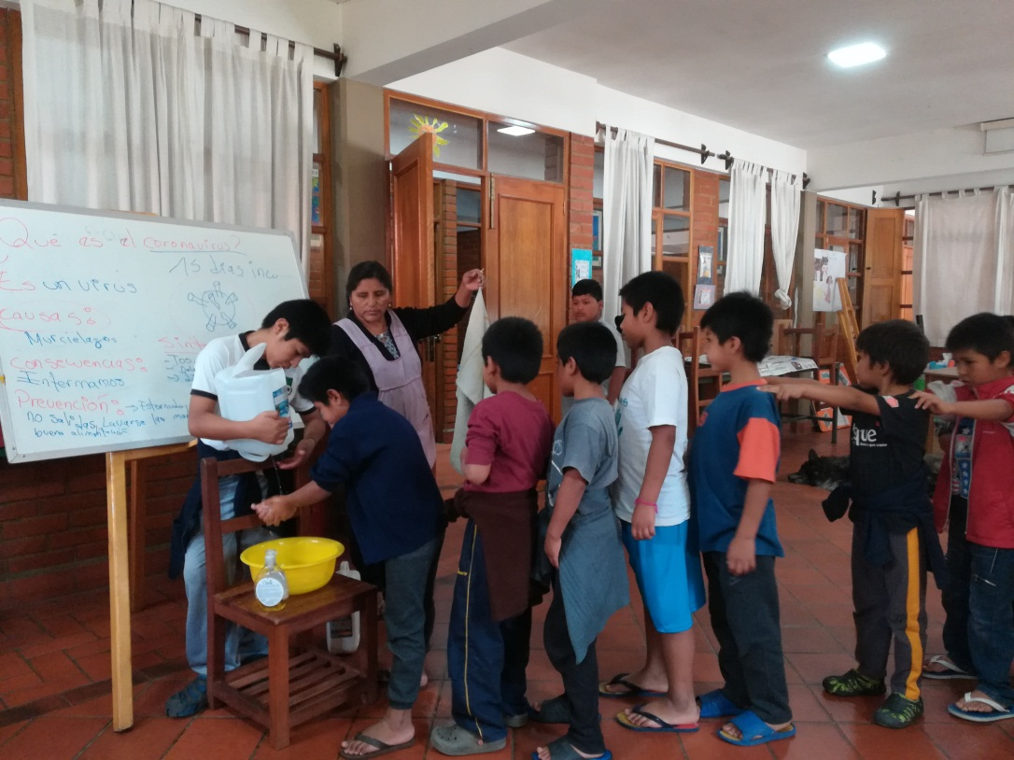
I hope you are learning how to wash your hands!!!!!
Let’s wash our hands. Corona is around.

Slide 7
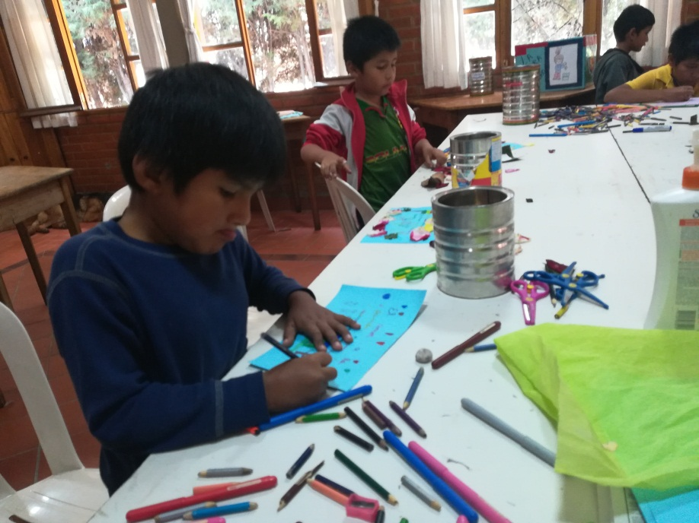
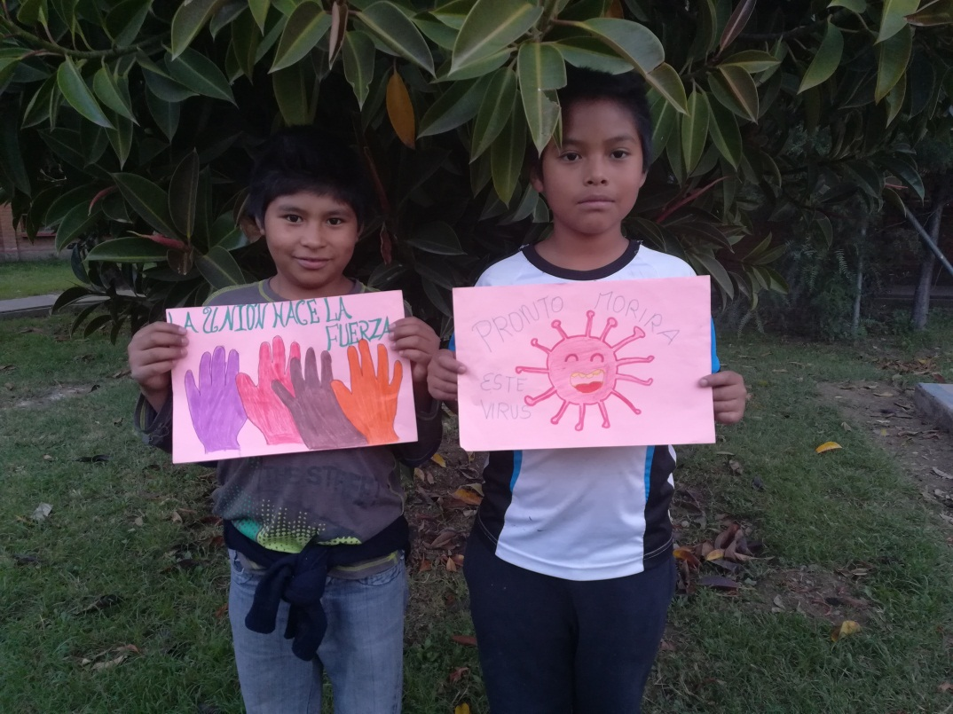
It's better if I paint quietly
Great job kids!

Slide 8
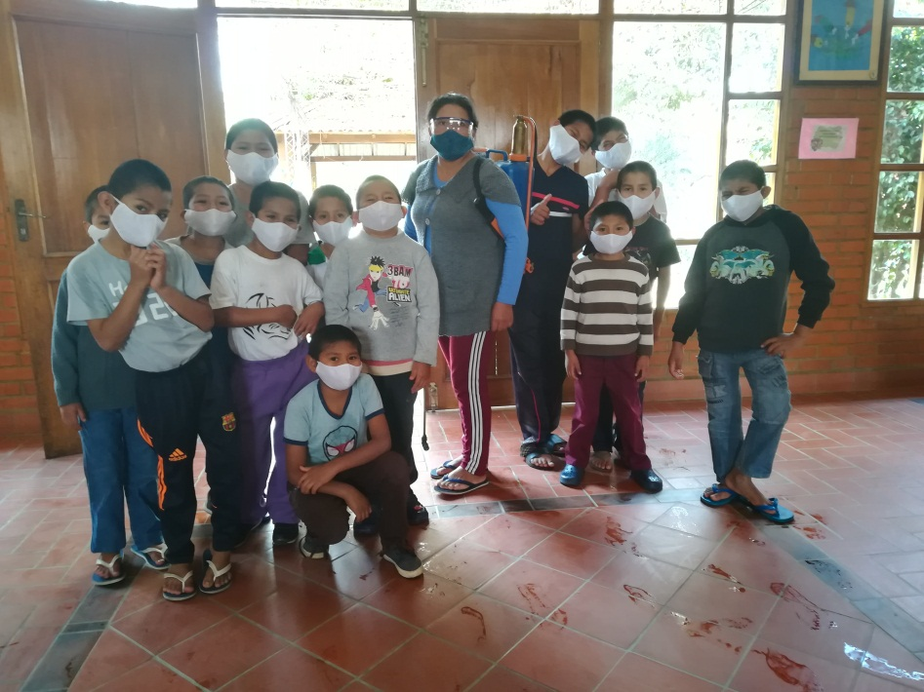
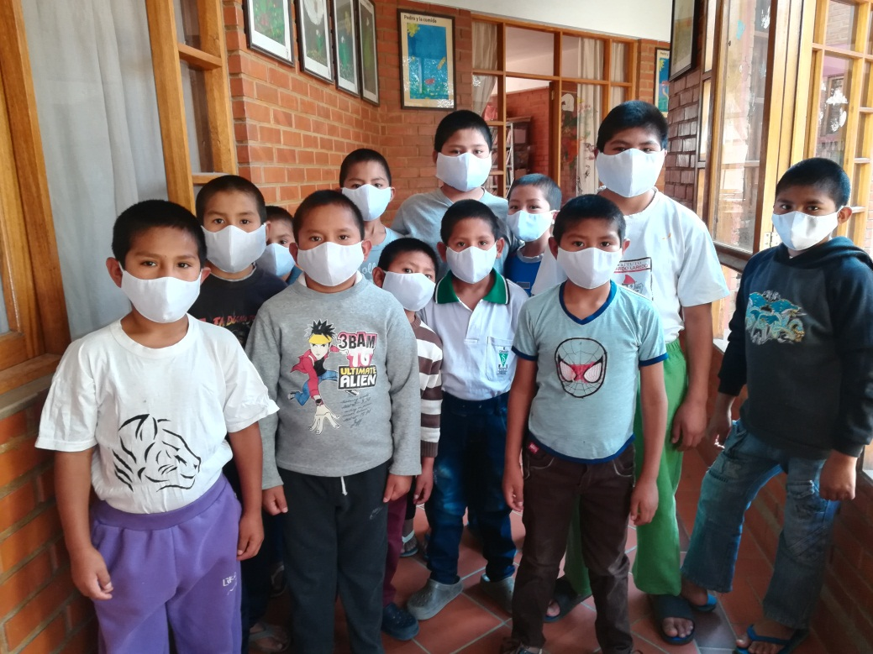
Learning to present the spread of the virus
I am so handsome!!!!!
Do you like our smiles?

Slide 9
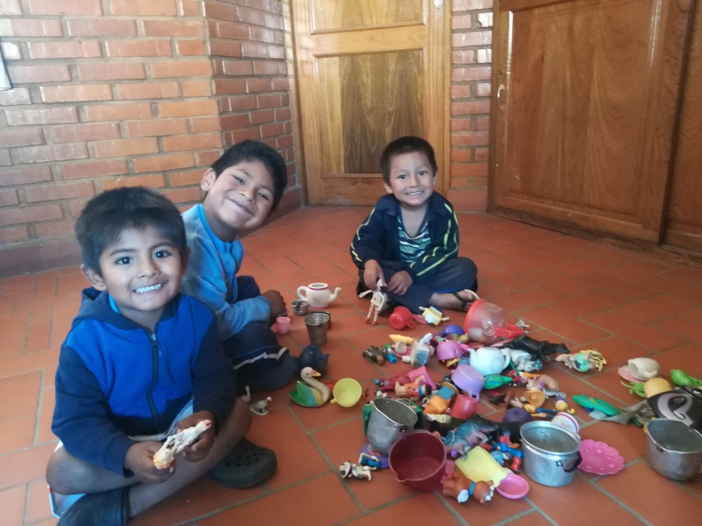
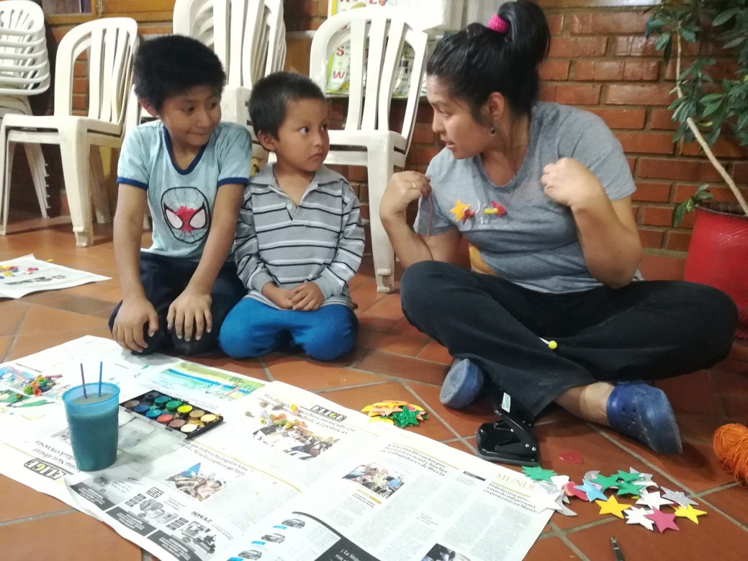
Fun in pandemic times
Staying at home is so much fun
I don’t understand what she is saying…I am going to say yes anyway.

Slide 10
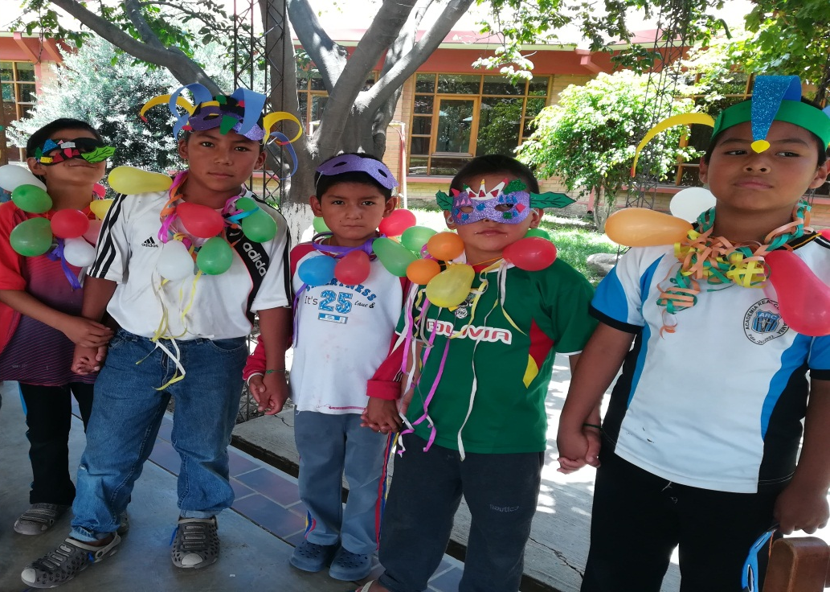
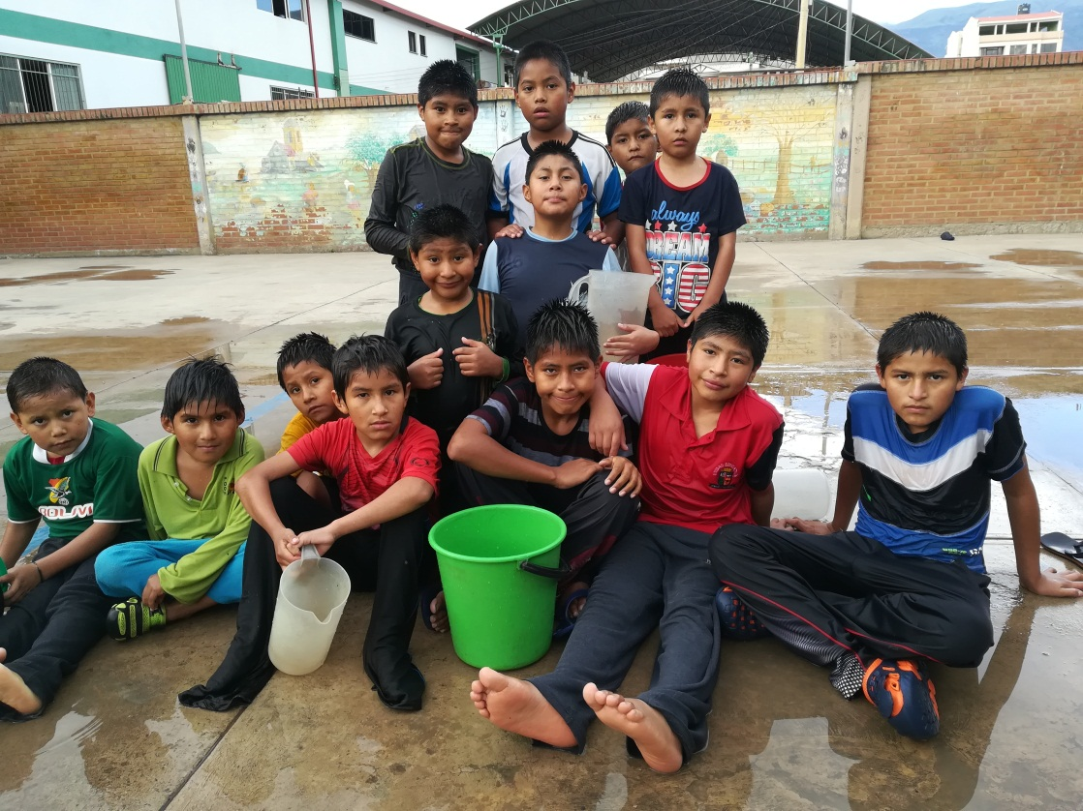
Still having fun
even during the pandemic
I liked doing the activity
Will we play again tomorrow?

Slide 11
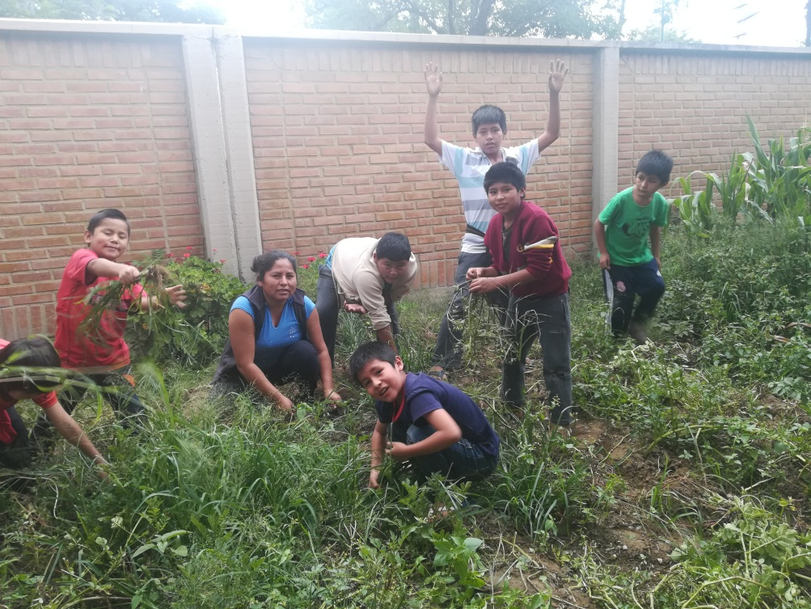
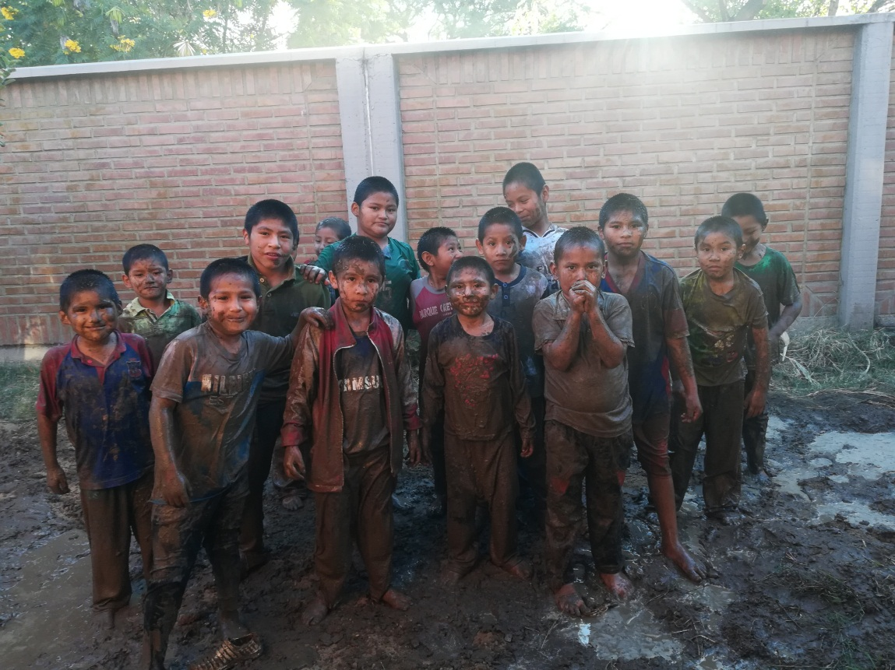
More fun…
Preparing the ground, hehehe!!!
I like gardening….
I'm cold….
So much fun!!!!

Slide 12
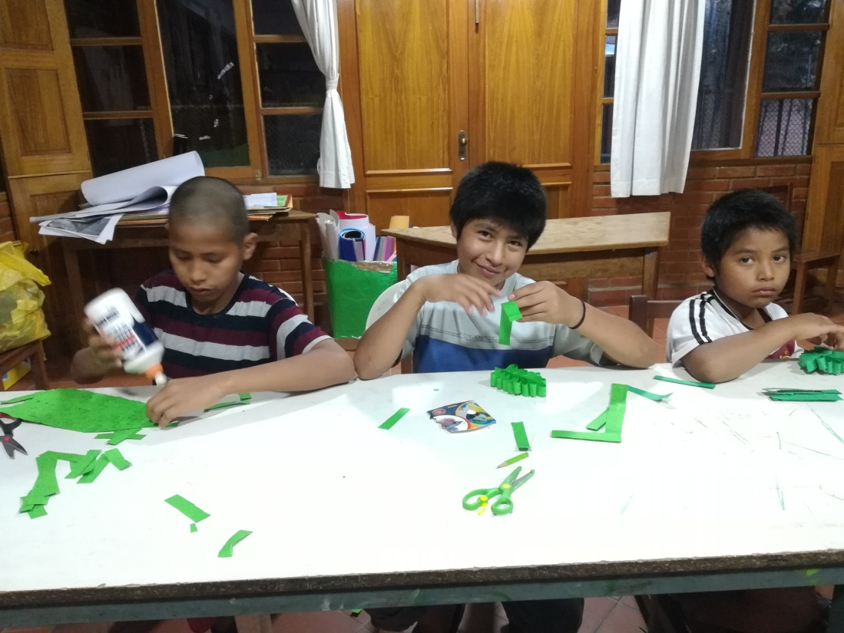
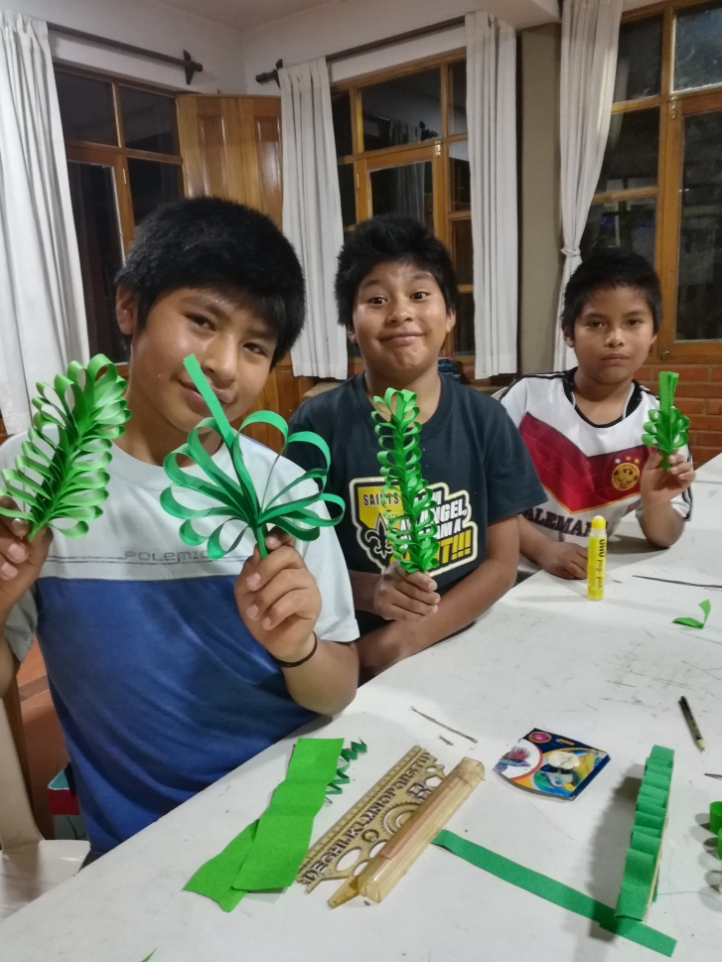
And more fun…
Preparing the palm trees……
Finally finished…

Slide 13
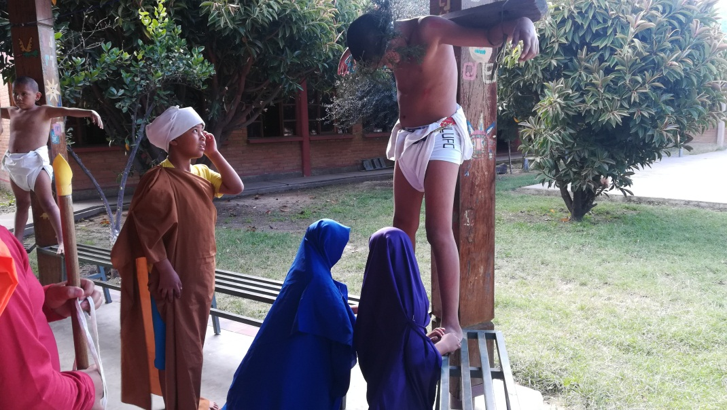
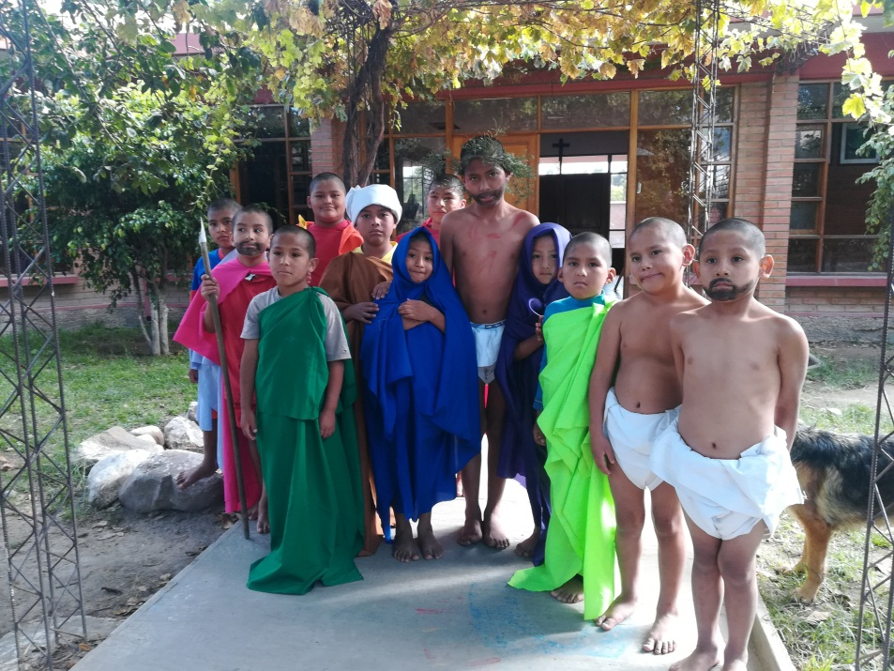
Catechesis
Live stations of the Cross
Our Lord Jesus suffered for us.

Slide 14
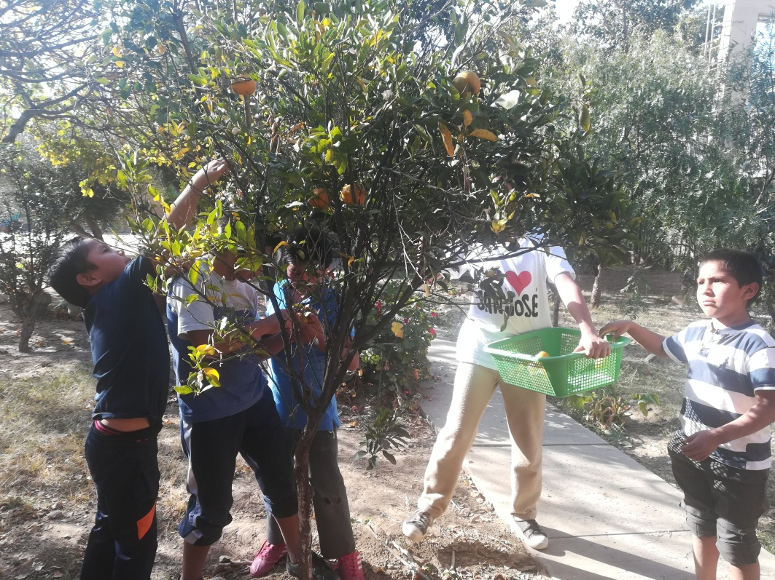
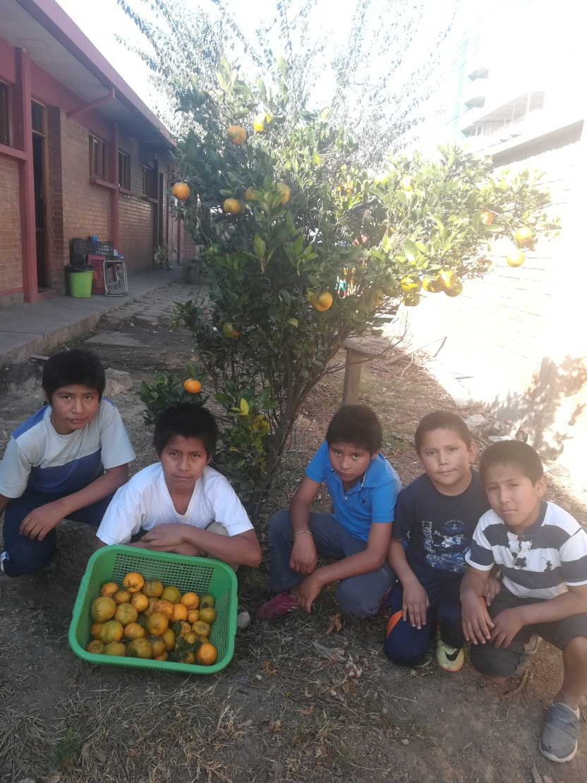
Oh, and some more fun
That one is too high. I wish I were taller!
Uuff…
We are tired, but now let’s go to eat these yummy oranges …

Slide 15
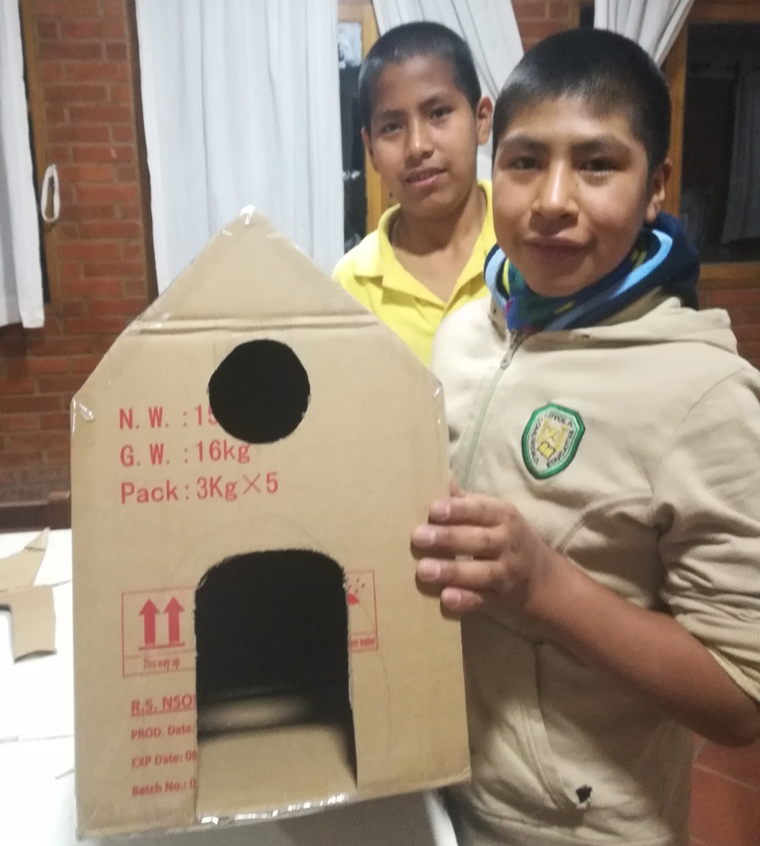
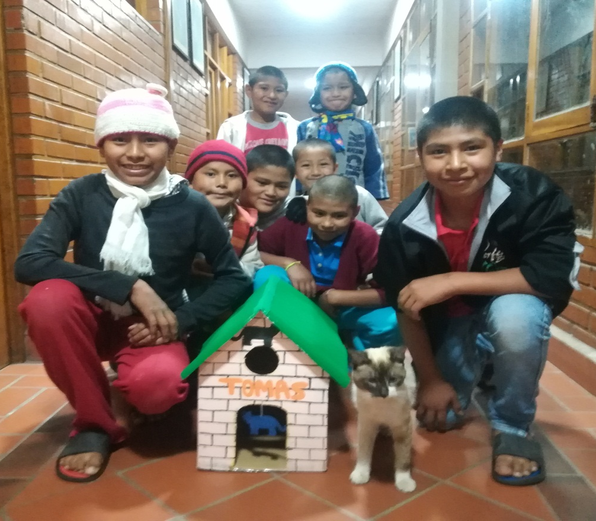
… and more fun
Now let’s go paint.. Yeah!
Tomas now has a warm house to sleep in!

Slide 16
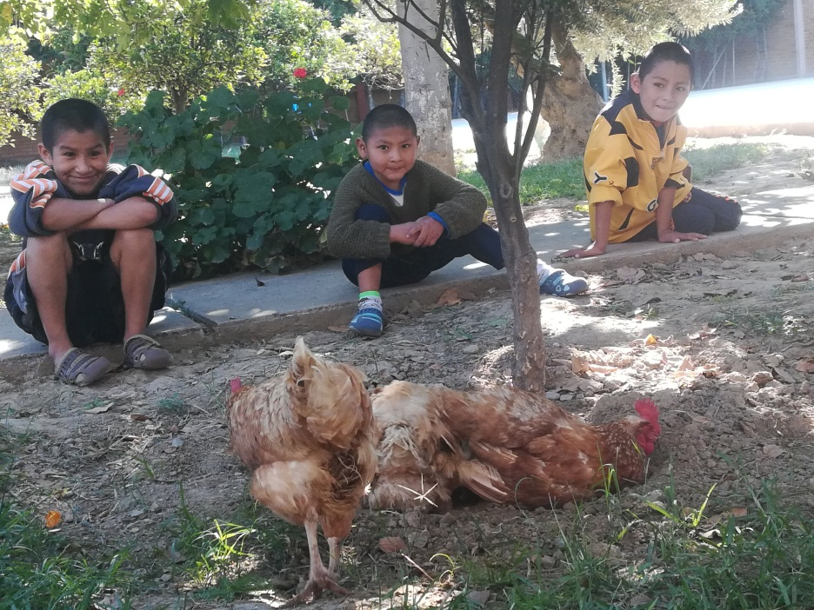
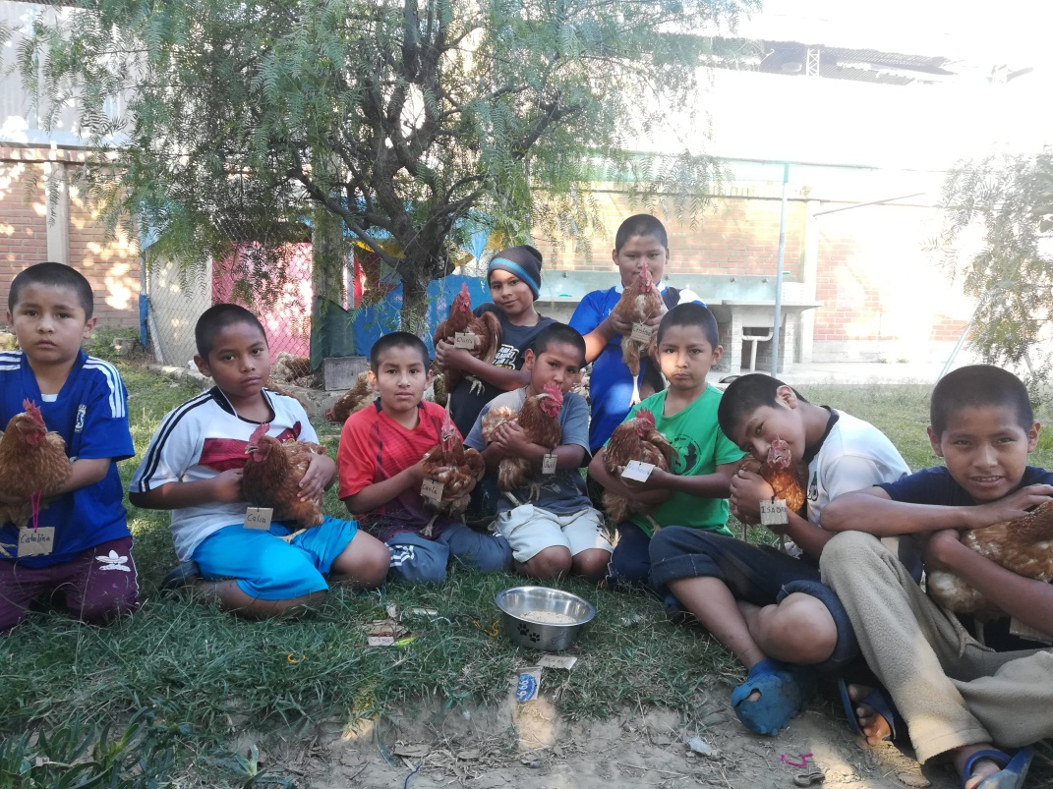
Still more fun…
That chicken is mine, and I’m gonna name it…
DEMI. That’s The name of the chicken

Slide 17
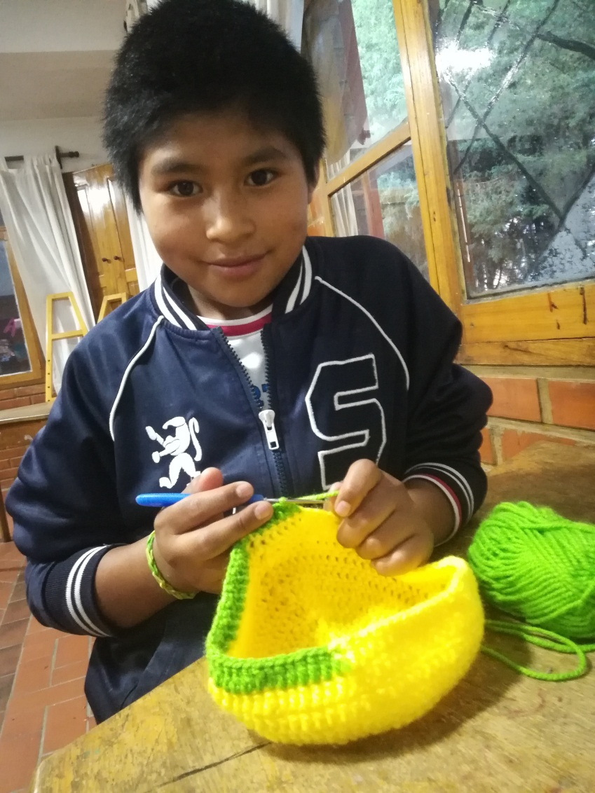
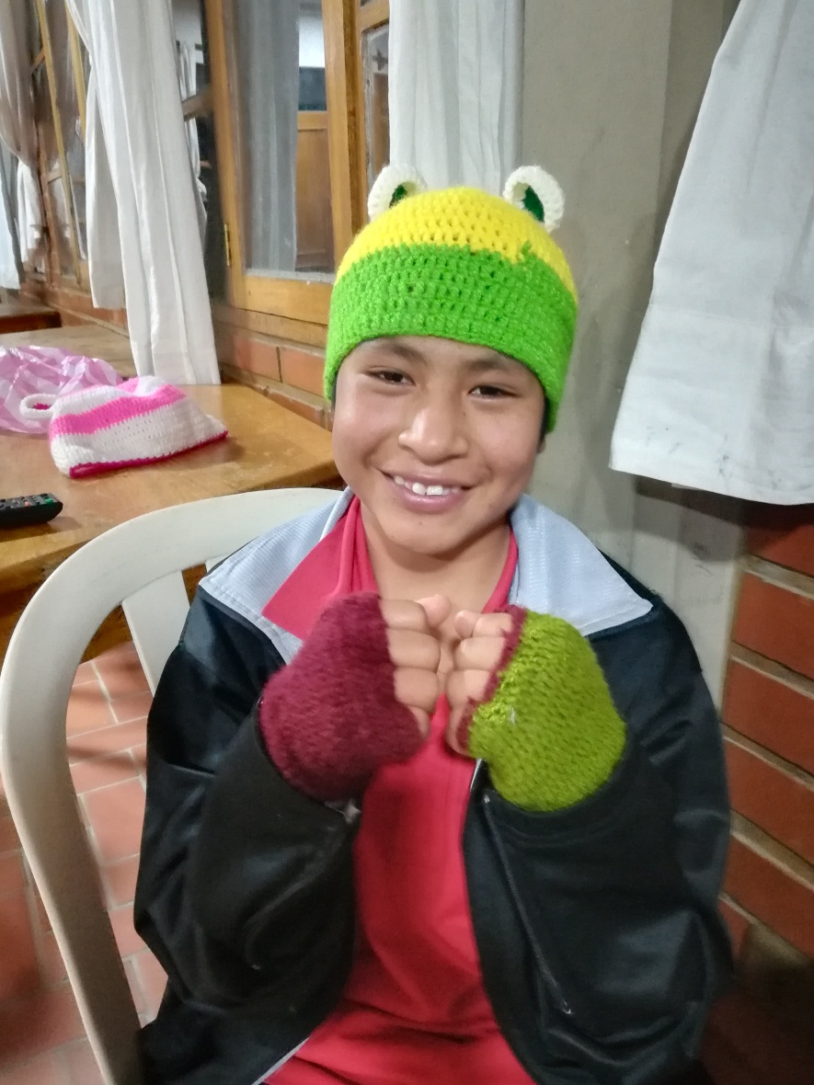
Learning while having fun
I learned how to knit!!!!
My hat matches the glove… Nice.

Slide 18
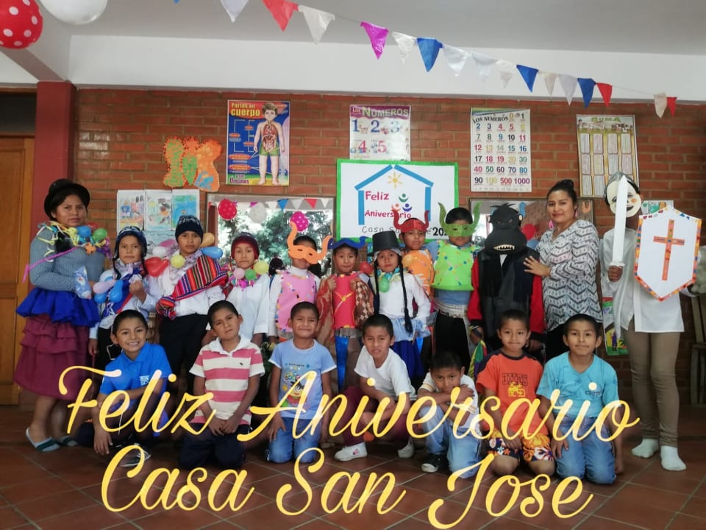
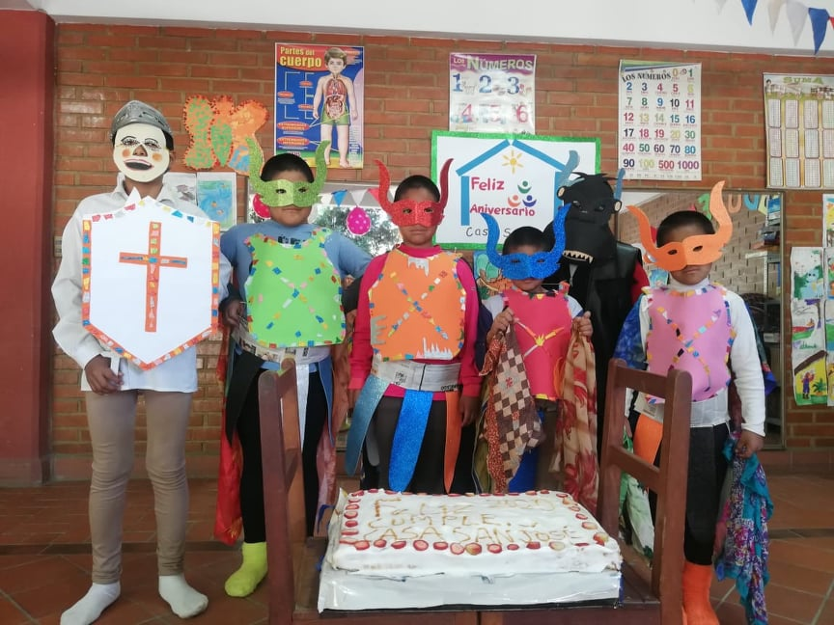
Still having fun…
Hope nobody recognizes me

Slide 19
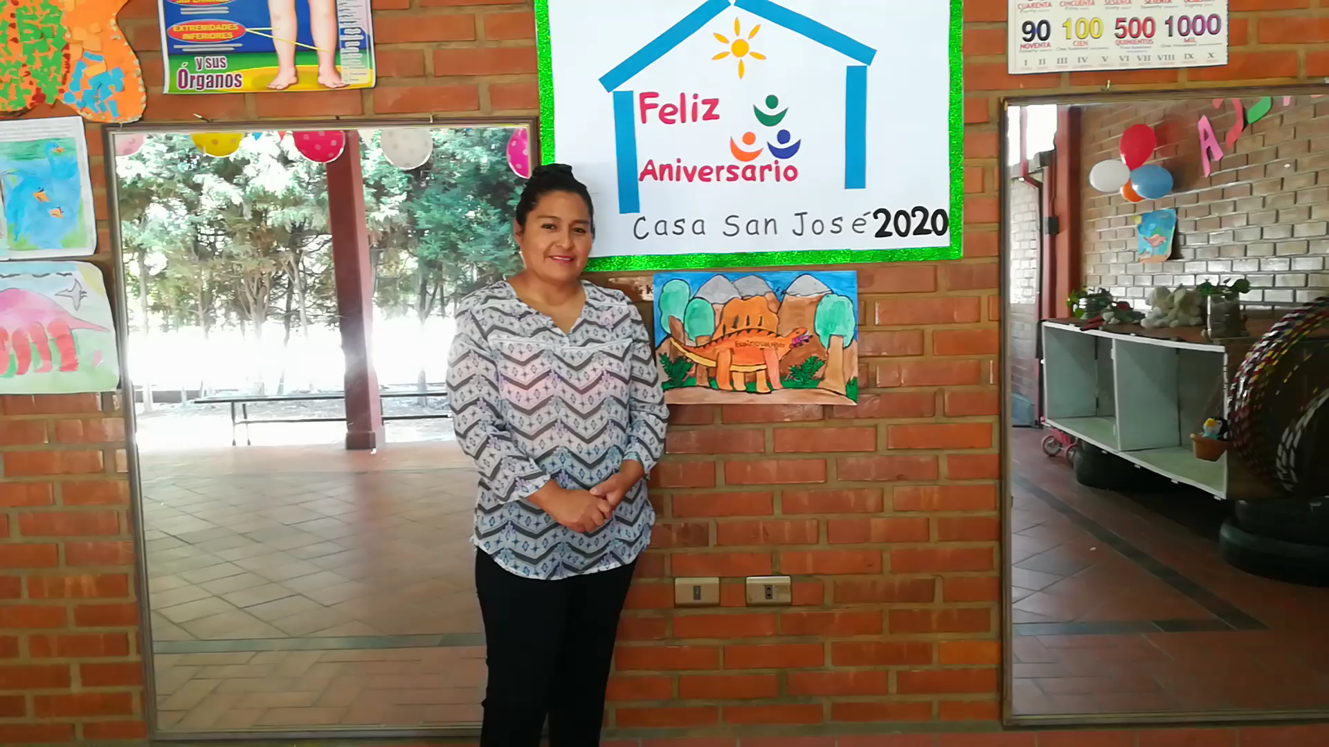
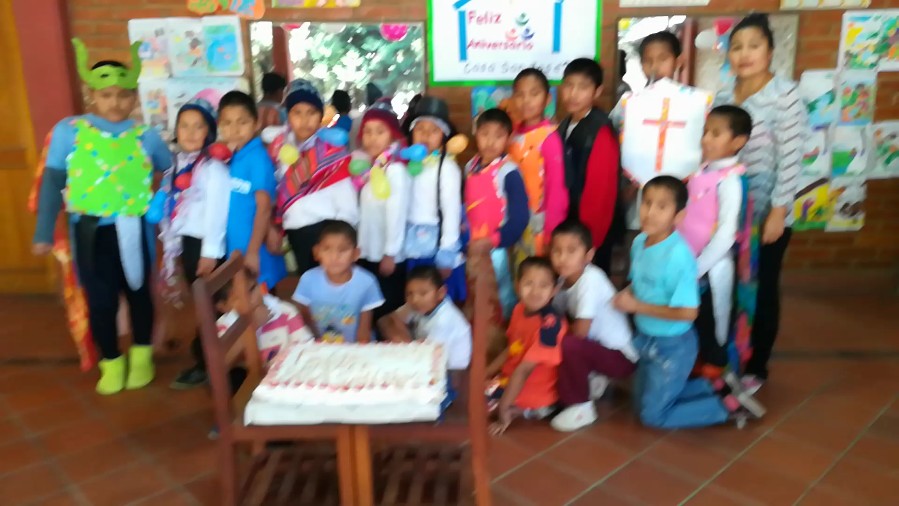
And celebrating…

Slide 20
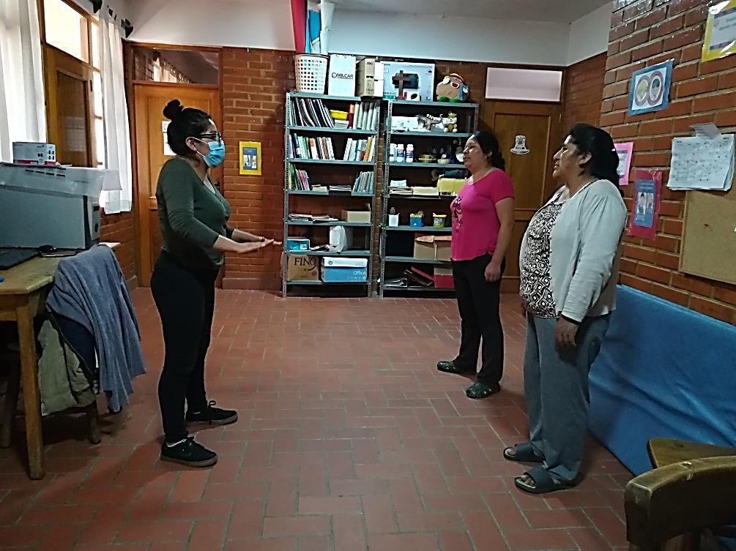
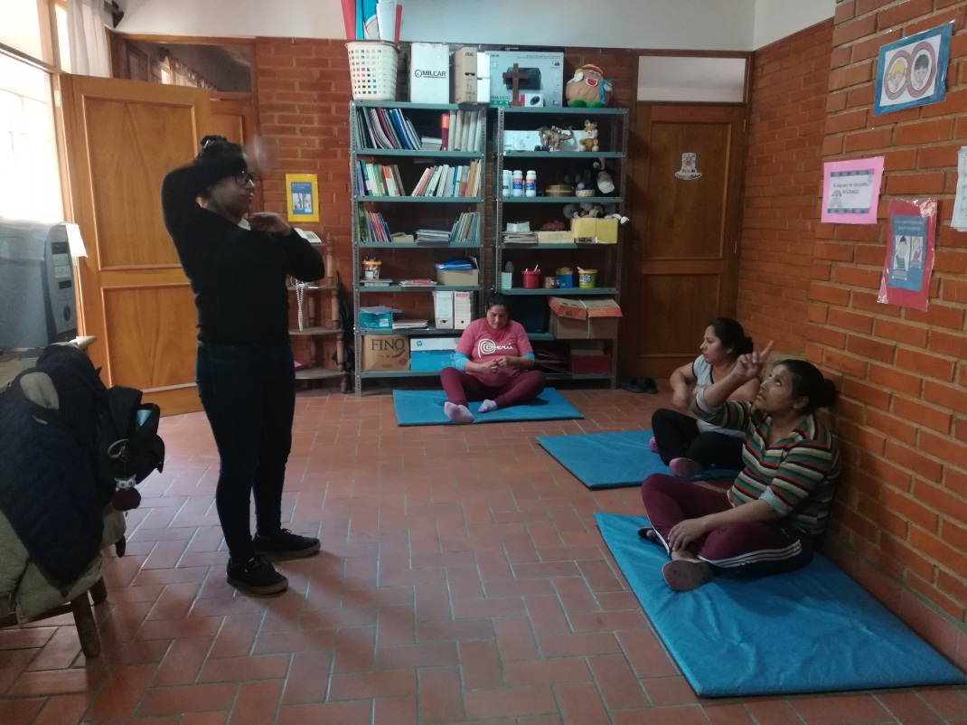
Also some relaxation activities
Wait, we´re going to dance…….??
Teacher, I hurt my finger…
My opinion is…

Slide 21
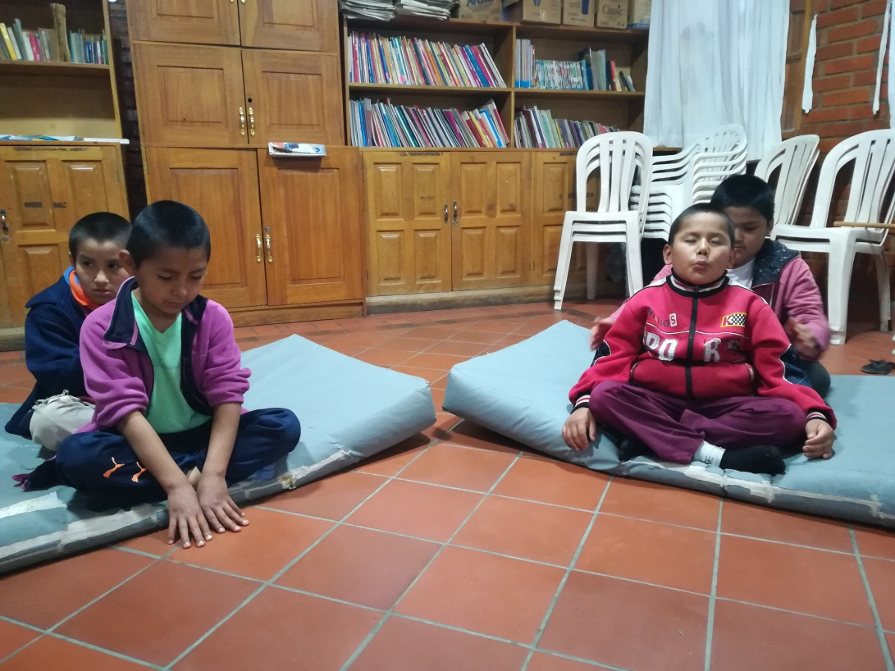
Relaxation activities
I'm sleepy, but I shouldn't sleep
When´s lunch?!

Slide 22
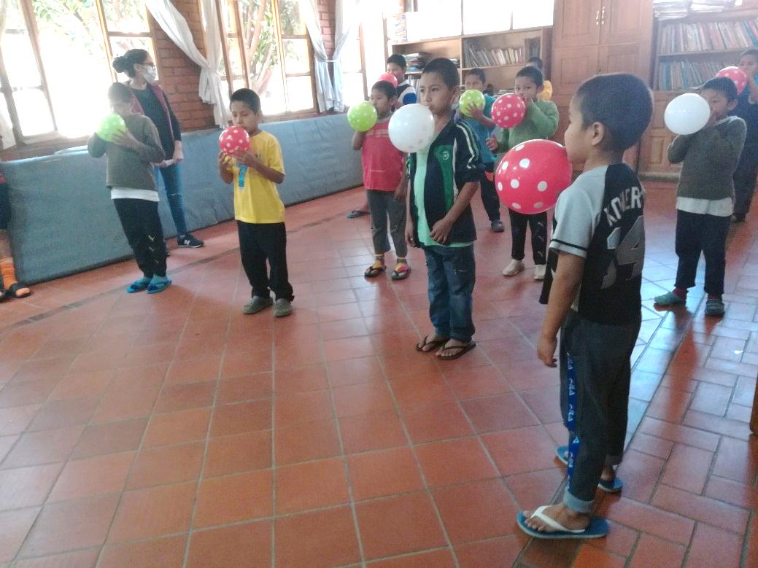
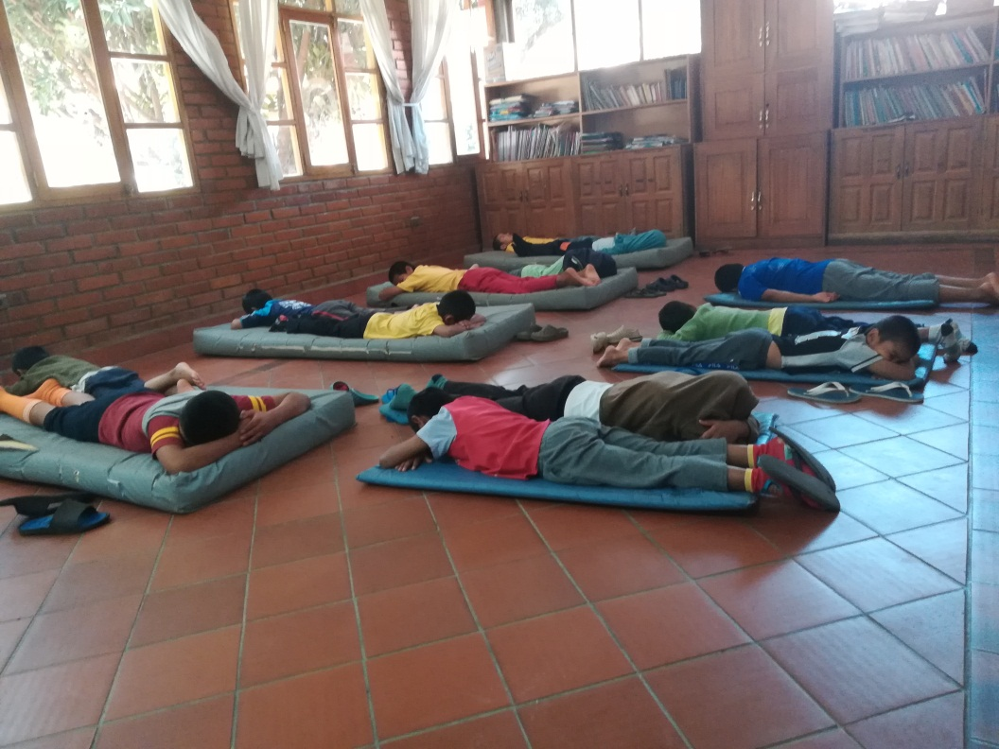
Relaxation activities
Oops I can't breathe
Sleeping is my favorite

Slide 23
St. Lucy and St. Sebastian. THANK YOU!!

